Slide 1
Slides for Chapter 2
Note to Instructors
This Keynote document contains the slides for “The Python Workbench”, Chapter 2 of Explorations in Computing: An Introduction to Computer Science and Python Programming.
The book invites students to explore ideas in computer science through interactive tutorials where they type expressions in Python and immediately see the results, either in a terminal window or a 2D graphics window.
Instructors are strongly encouraged to have a Python session running concurrently with Keynote in order to give live demonstrations of the Python code shown on the slides.
License
The slides in this Keynote document are based on copyrighted material from Explorations in Computing: An Introduction to Computer Science and Python Programming, by John S. Conery.
These slides are provided free of charge to instructors who are using the textbook for their courses.
Instructors may alter the slides for use in their own courses, including but not limited to: adding new slides, altering the wording or images found on these slides, or deleting slides.
Instructors may distribute printed copies of the slides, either in hard copy or as electronic copies in PDF form, provided the copyright notice below is reproduced on the first slide.
© 2015 John S. Conery

Slide 2
The Python Workbench
Introducing Python and an environment for interactive experiments
Interacting with Python
Numbers, Functions, and the Math Module
Variables
Defining New Functions: def Statements
Conditional Execution: if Statements
Strings
Objects

Slide 3
Computer Programs
From previous slides:
a computation is a sequence of well-defined operations that lead from an initial starting point to a desired final outcome.
a computation is a process that can be carried out by a person or a machine
If we want a machine to carry out a computation on, we need to write a program
A programming language is a notation for describing the steps of a computation
The earliest programming languages were developed in the 1950s
FORTRAN, COBOL, ALGOL, LISP, ....
Languages widely used today include Java, Perl, C++
The language used in this textbook is named Python

Slide 4
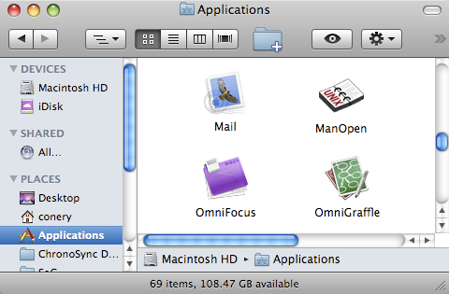
Applications
Normally when we think of programs we think of applications
Applications folder on a Mac OS X laptop
A program for composing and reading e-mail

Slide 5
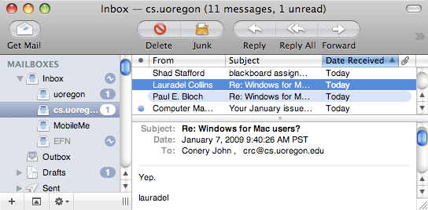
Applications (cont’d)
When we launch an application the system starts a program
inside the application are statements in a programming language
the statements tell the system how to create windows, where to place buttons and menus, etc

Slide 6
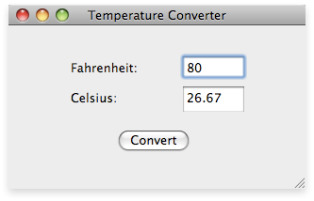
Applications with Python
It is possible to develop a complete application using Python
figure out what windows, menus, buttons, etc are needed
these “widgets” define the graphical user interface of the program
attach a set of Python statements to each widget
when a user clicks on a widget the Python code is activated
But writing a complete application is very hard work
requires lots of experience, extensive knowledge of programming libraries

Slide 7
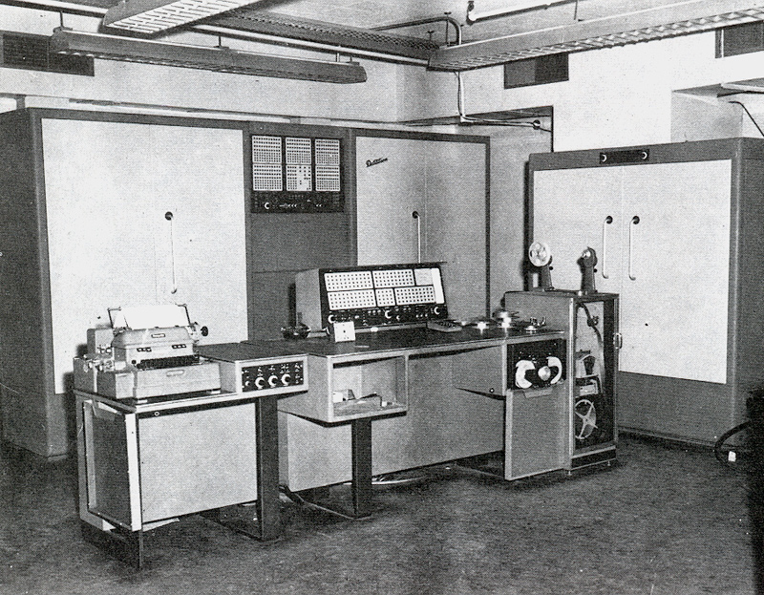
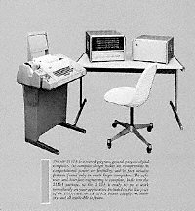
Before Graphical Interfaces
In the early days of computing there were no graphical displays
no mice
no display terminals
Programs were typed in on keypunch machines (which produced punched cards) or typewriters or teletype machines
www.computerhistory.org

Slide 8
Interactive Computing
Most programs in this era used batch processing
programs and data were typed on a keypunch machine
an operator would load a set of cards into the machine
a scheduler (part of the OS) ran programs one at a time
often a user would submit a program, return the next day to get results
If a computer had a typewriter, it was possible to run an interactive program
the user would type a command
the processor ran the program
when the program was done the system would print the results
an effective way of running smaller programs

Slide 9
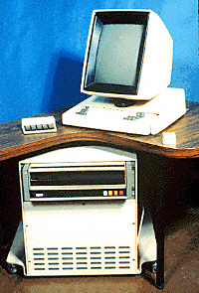
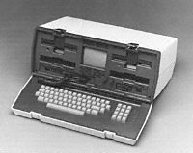
Terminals
In the 1970s video terminals replaced typewriters and teletypes
electronic keyboard
video display instead of paper
encouraged the development of interactive applications
Osborne-1 (first laptop)
www.computerhistory.org
www.computerhistory.org

Slide 10
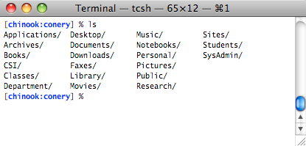
Terminal Emulator
The style of computing where a user types a command to launch a computation is still widely used today
instead of a real terminal, however, we use a terminal emulator
The main window in the terminal emulator application represents the screen from an old-fashioned video terminal
when the emulator is running, keystrokes you type are sent to the OS
you can start a program, and everything the program prints is displayed in the window
a prompt (means the system is ready for users to type a command)
a command (means “list the content of the current folder”)

Slide 11
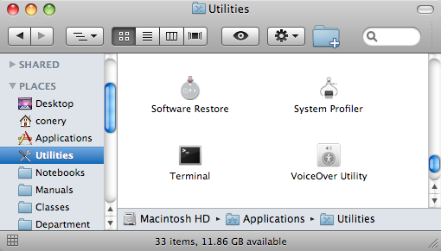
Terminal Emulator on Mac OS X
Terminal emulators are part of every operating system
in Mac OS X, the application is named Terminal
look in the Utilities folder inside your top level Applications folder

Slide 12
Terminal Emulator on Windows 7
Windows users can run a program named Command Prompt
find it in the Accessories folder

Slide 13
Command Line Editing
Terminal emulators have lots of “bells and whistles”
A very effective skill to know for the lab projects is command line editing
hit the up-arrow key, go back and edit the previous command -- saves typing
you can also hit delete and use other keys to edit the expression
See the Online Lab Manual for more information about starting and running a terminal emulator on your system
http://www.cs.uoregon.edu/eic/python

Slide 14
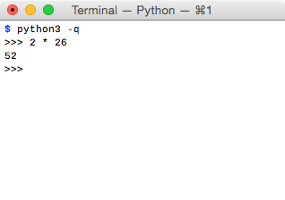
Running Python Interactively
We will be using Python as an interactive programming language
An interactive language is basically a fancy calculator
start Python
Python prints a prompt to let you know it is ready
type an expression
Python evaluates the expression and prints the result
go back to step 2
The CS jargon for this cycle is read-eval-print loop
OS command to start Python

Slide 15
Interactive Python Examples
For the remaining slides Python examples will be shown without a picture of a terminal emulator
we will assume you know how to start Interactive Python on your system
the Python commands shown in these slides should work equally well on Mac OS X, Windows, or Linux systems
In lecture slides, prompts and other strings printed by Python will be shown in black, and characters typed by a user will be shown in green
Example: a “hello world” program:
>>> print("hello")
hello
Python statement typed by user
result printed by Python
Python’s prompt

Slide 16
Arithmetic Expressions
The simplest statements in Python are arithmetic expressions
arithmetic expressions contain numbers (operands) and operators
The symbols used for operators are commonly used in other languages and applications (e.g. spreadsheets)
add: +
subtract: -
multiply: *
divide: /
>>> 5 + 12 17
>>> 3 + 4 * 5 23
>>> 4 * 4 / 2 8.0

Slide 17
Arithmetic Expressions (cont’d)
Use parentheses if you want to alter the standard order
Note that Python converts integer values to real numbers as needed (more on the next slide)
>>> 3 + 4 * 5 23
>>> (3 + 4 ) * 5 35
>>> 19 / 3 6.333333333333333
>>> 19 // 3 6

Slide 18
Floating Point Numbers
Numbers inside a computer are finite approximations
real numbers like 1/3 have an infinite number of digits
Python and other programming languages have a finite number of digits
From http://www.joyofpi.com/pi.html:
π = 3.141592653589793238462643383279...
In Python:
>>> from math import pi
>>> pi 3.141592653589793
In computer science finite approximations of real numbers are known as floating point numbers (or “floats”)
Python’s math library includes a definition of π

Slide 19
Variables
To motivate the next topic, suppose you want to compute the surface area of a counter top
you know the counter is a square with a triangular piece missing
you also know each side of the triangle is half as long as the side of the square
Using some simple geometry will give you an equation for the area of the counter

Slide 20
Variables (cont’d)
Suppose you measure one edge of the square to get x = 109 cm
Python can compute the area for you:
>>> 109 * 109 - ((109/2)*(109/2) / 2) 10395.875
You can simplify this a little bit by using the exponentiation operator
to compute x² type x**2
>>> 109**2 - (109/2)**2 / 2 10395.875

Slide 21
Variables in Python
You can make the equation even simpler by using a variable
create a value named x, and then write the equation using x
>>> x = 109
>>> x**2 - (x/2)**2 / 2 10395.875
The first expression defines a variable named x, and the second uses the value of x to compute the area
An expression of the form “x = ...” is known as an assignment statement
put the name of a variable on the left side of the assignment operator
put any expression on the right side
Python evaluates the expression and saves the result

Slide 22
Variables Can Be Updated
You can change the value of a variable
simply assign it a new value in another assignment statement:
>>> x = 109
>>> x**2 - (x/2)**2 / 2 10395.875
>>> x = 111
>>> x**2 - (x/2)**2 / 2 10780.875

Slide 23
Variable Names
There are a few rules for defining names for variables:
names can be as long as you want
>>> supercalifragilisticexpialadocious = 3.14
3.14
>>> supercalifragilisticexpialadocious * supercalifragilisticexpialadocious
9.8596
case is important (a is not the same as A)
names must start with a letter, but can have digits or underscores
note: by convention variable names in Python start with lower case letters

Slide 24
Strings
Numbers aren’t the only type of data found in programs
We’ve already seen that Python can print a sentence:
>>> print("hello, world")
hello, world
A set of letters enclosed in quotes is known as a string
We can store strings in variables:
>>> s = "hello"
>>> print(s) hello

Slide 25
String Operators
There are lots of things we can do with strings
Example: when the operands are strings, the + operator attaches one string to the other:
>>> s 'hello'
>>> s + ", world" 'hello, world'
We’ll come back to strings later in this chapter
For now, just know that Python has several different types of data; the ones we’ve seen so far are
integers
reals (“floats”)
strings

Slide 26
Objects
The slides that introduced Python said it belongs to a family of languages known as object-oriented languages
The term object simply means “generic piece of data”
Integers, floating point numbers, and strings are some of the types of objects that Python can deal with
Some other types of objects include
lists of numbers
dates
objects used to build graphical interfaces, e.g. windows and menus
Python has several dozen pre-defined types of objects
It also allows programmers to define new types

Slide 27
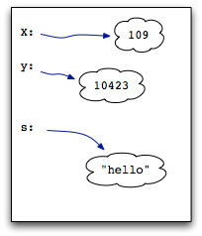
Variables Are Labels for Objects
Think of the memory of your computer (RAM) as being one big “object storage unit”
When Python evaluates an assignment statement, it creates a new variable if it does not already exist
>>> x = 109
>>> y = x**2 - (x/2)**2 / 2
Variables can refer to any type of object
we’ll see examples of strings and other more complex objects later
Object Store

Slide 28
Object Store
In pictures like the one at right objects are drawn as small “clouds”
the clouds mean the objects are abstract ideas
as users we typically don’t care how the computer represents objects in memory
all we care about is that fact that we have created a variable and assigned it a value
we let the computer figure out how to store the value internally
Object Store

Slide 29
Functions
Earlier we saw Python has a math library
the library has numbers (e, π, etc)
it also has a variety of useful functions
To use these items we have to import them:
>>> from math import sin, cos, radians, pi
>>> sin(pi/4) 0.7071067811865475
>>> cos(radians(60)) 0.5000000000000001

Slide 30
Terminology
Here is some important terminology used when discussing functions:
when a function is used in an expression we call the function
a function call can include arguments
we say the arguments are passed in to the function
functions return values that can be used in the original expression
Example: when the sin functions is passed the value 1 it returns 0.84...
>>> sin(1.0) 0.8414709848078965

Slide 31
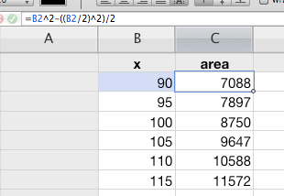
Defining New Functions
One of the most widely used features of any programming language is the ability to define new functions
Example: suppose we need to calculate the size of several countertops
same shape, different edge length
One approach: make a spreadsheet
enter sizes in one column, a formula for the area in a second column

Slide 32
Defining New Functions (cont’d)
The equivalent idea in Python is to write a new function and call it several times
After we define the function we can import it and call it from an interactive session:
>>> from countertop import *
>>> countertop(105) 9646.875

Slide 33
def
To define a new function in Python we use a def statement
This example shows how to define the function that converts temperatures:
def celsius(f):
return (f - 32) * 5 / 9
The statement has the word def and the name of the function we want to define
If the function uses arguments write their names in parentheses after the method name (the names are called “parameters”)
The lines following the def statement make up the body of the function
these statements are executed when the function is called
one of the statements is typically a return statement that specifies the value to be returned as the result of the function call
Don’t forget the colon at the end of the def statement

Slide 34
def
An important note:
the statements in the body of a function must all be indented
every statement must be indented exactly the same number of spaces
a Python community standard: use 4 spaces
Here is another example, this time for the countertop function:
def countertop(x):
square = x ** 2
triangle = ((x / 2) ** 2) / 2
return square - triangle

Slide 35
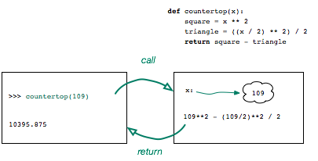
def
Python saves the definition of the function
we can call it whenever we want to compute the area of a countertop
when the function is called Python creates the variable x and assigns it the value passed as an argument
Python then executes the statements in the body using this value of x

Slide 36
Abstraction
One of the most important concepts in computer science is the idea of abstraction
when we define a function like countertop we’re making a small “package”
from outside we forget about the details -- all we care about is the fact that we can call this function and it will do a computation

Slide 37
Keywords
The word def is a keyword
keywords are words that have special meaning in a programming language
they cannot be used as the names of variables or functions
if you try to use a keyword as a variable name you’ll see something like this:
>>> def = 14
SyntaxError: invalid syntax
Python has several other keywords -- we’ll introduce them as they are needed

Slide 38
Defining Functions
For short definitions we can just type the entire definition on a few lines in an interactive session
>>> def f(x): ... return x**2 - x ...
>>> f(10) 90
>>> f(5) 20
For more complicated definitions it is more convenient to put the definition in a file, and then import the file
>>> from countertop import *
The prompt changes to three dots to show you the input is a continuation of a previous statement
Note how the line in the body is indented
After typing the last line just hit the return key
Python automatically attaches “.py” to make the name of the file to import

Slide 39
Using a Text Editor
To create the file you can use any application that operates on text files
Programmers use applications known as text editors
there are lots of them out there
many good ones are free:
Text Wrangler (Mac OS X)
gedit (Linux)
notepad++ (Windows)
See the Lab Manual for suggestions and for more information about using a text editor

Slide 40
Tutorial Project: Temperature Converter
To get some experience with the “Python Workbench” do the tutorial project in Ch 2 of Explorations in Computing
The project takes you through the steps of writing and testing the function that converts temperature values from Fahrenheit to Celsius
when you have completed the tutorial, you will have a method definition in a file named celsius.py
>>> from celsius import *
>>> celsius(72) 22.22222222222222
>>> celsius(32) 0.0
>>> celsius(212) 100.0

Slide 41
Conditional Execution
Often an algorithm needs to make a decision
which steps are executed next depend on the outcome
Example: when computing tax rates compare a person’s income
if the income is above a certain minimum use one tax rate, otherwise use a lower rate
In Python an if statement allows us to test conditions and execute different steps depending on the outcome
def tax_rate(income):
if income < 10000:
return 0.0
else:
return 5.0
The value returned by this function depends on the value passed as a parameter

Slide 42
Syntax of if Statements
The structure of an if statement is similar to a def statement
if income < 10000:
return 0.0
else:
return 5.0
the words if and else are keywords
note the colon at the end of the if and else statements
note also how the statements to be executed are indented
we can have as many statements as we want in each section but they all have to be indented the same

Slide 43
Multiple Choice
When an algorithm needs to choose among more than two alternatives it can use an elif statement
elif is short for “else if”
This function distinguishes between three tax categories
def marginal_tax_rate(income):
if income < 10000:
return 0.0
elif income < 20000:
return 5.0
else:
return 7.0
We can use as many elif parts as we want

Slide 44
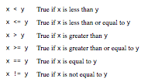
Boolean Expressions
The expressions in if and elif statements are special kinds of expressions
the result of these expressions is either True or False
An expression that evaluates to True or False is called a Boolean expression
Boolean expressions often involve comparison operators

Slide 45
Strings
Earlier examples showed that Python can work with pieces of text as well as numbers
>>> s = 'Hello'
>>> t = "Who's there?"
In programming terminology these objects are known as strings
Python strings can begin and end with single quote or double quotes
typically strings have to fit on a single line in a program
later we’ll see another way of writing strings that can span multiple lines

Slide 46
Operators and Strings
When the operands in an expression are numbers the + and * operators have their usual meaning
But when used with strings the operators do something different
The plus symbol joins two strings into a single longer string
>>> s 'Hello'
>>> s + '?' 'Hello?'
The asterisk repeats a string a specified number of times
>>> s * 3 'HelloHelloHello'

Slide 47
String Functions
A Python function named len (short for “length”) will count the number of characters in a string
>>> s ‘Hello'
>>> len(s) 5
>>> t "Who's there?"
>>> len(t) 12
Note that len counts every character in a string, including spaces and punctuation

Slide 48
Methods
Many other functions on strings are called using a different syntax
Instead of writing
f(s)
we write
s.f()
In this new form, the name of the string is written first, followed by a period, and then the function name is written after the period
Functions that are called using this syntax are referred to as methods
It may seem confusing at first to have two different ways to call functions.
This new syntax and terminology is very common in object-oriented programming and will seem natural as we see more examples and how it is used with other types of objects besides strings.

Slide 49
Example: Working with Words
As an example of a string method consider how we might figure out how many words are in a sentence
if there is exactly one space between each word we just need to count the number of space characters
the method named count does exactly that:
>>> sentence = "It was a dark and stormy night."
>>> sentence.count(' ') 6
Note the argument passed to count is a string that contains exactly one character, a single space character

Slide 50
Example: Beginnings and Endings
Two other useful methods are startswith and endswith
They are both Boolean functions and return True or False depending on whether a string begins or ends with a specified value
>>> sentence 'It was a dark and stormy night.'
>>> sentence.startswith("It") True
>>> sentence.startswith("It's") False
>>> sentence.endswith("?") False
>>> sentence.endswith(".") True

Slide 51
Tutorial Project
To help you gain some experience with function definitions, if statements, and strings, a tutorial project in this chapter shows how to write a function that returns the plural form of a noun
>>> plural('duck') 'ducks'
>>> plural('cat') 'cats'
>>> plural('glass') 'glasses'
>>> plural('wife') 'wifes'
>>> plural('mouse') 'mouses'
The function simply adds ’s’ to most words
It checks to see if a word already ends with ’s'
Can you add new tests to have the function return the correct string for more words?

Slide 52
Another Look at Objects
The term “object” was introduced earlier to mean “generic piece of data”
So far we’ve seen
numbers (integers and floating point)
strings
Booleans (True and False)
In the next chapter we’ll see how to create lists of numbers
a list is also a kind of object
Throughout the book we will encounter many other kinds of objects
some are part of the Python language
some were developed specifically for this book
in Chapter 7 we’ll see how to define our own kinds of objects

Slide 53
More Terminology for Objects
In object-oriented programming terminology:
the word class refers to a type of data
an individual object is an instance of a class
we also sometimes say an object “belongs to” a class
functions that are defined as part of a class are methods
When we ask Python to evaluate an expression, it first checks to see what sort of objects are used in the expression
it then chooses the operation or function or method that is defined for that type of object
>>> x = 7
>>> x * 3 21
>>> x = 'est!'
>>> x * 3 'est!est!est!'
When x refers to an integer x * 3 means one thing, but when x refers to a string x * 3 is evaluated differently

Slide 54
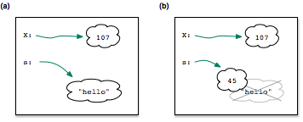
Variables are Just Labels
When we change the value of a variable, Python throws away the old object (the previous value) and replaces it with a new one
>>> s = "hello"
>>> s = 5 * 9
Since variable names are just labels Python doesn’t care if the new value is the same type of object

